Slide 1
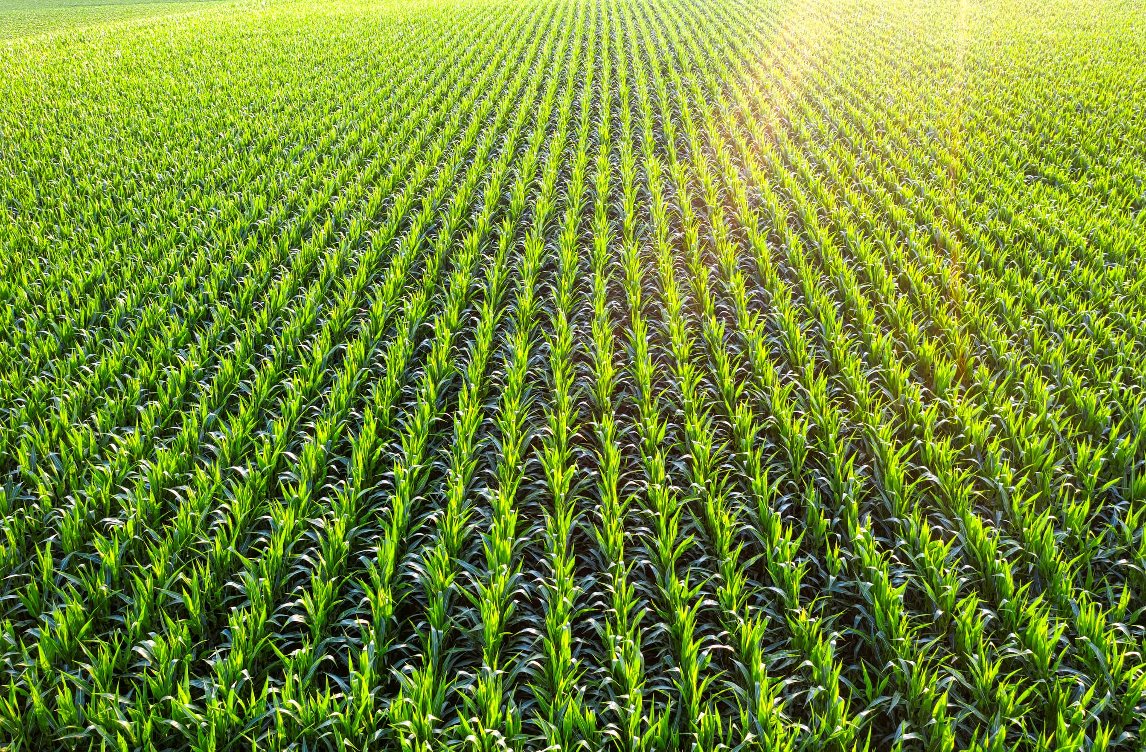
AGRICULTURAL CROP PRODUCTION & YIELD OPTIMIZATION ANALYTICS SYSTEM
Capstone Project
Presented by
Name: MARUMUDI ASHRITHA
Track: Data Engineering
email: ashritham23@gmail.com
VNR Vignana Jyothi Institute of Engineering and Technology

Slide 2

Addressing the Business Challenge in Agriculture
Agricultural data is scattered across multiple raw files
Manual analysis leads to delays and inaccuracies
Limited visibility into key metrics:
Yield trends
Seasonal performance
Low-productivity regions
Need for a centralized and automated analytics system to improve efficiency and decision-making

Slide 3
Key Objectives for Enhanced Agricultural Insights
Automate Data Processing
Perform Yield Analytics
Identify High/Low-Yield Regions
Analyse production and yield to identify key patterns.
Streamline ingestion and processing of crop data.
Pinpoint areas of exceptional or poor performance.
Enable Data-Driven Planning
Deliver Interactive Dashboards
Facilitate informed agricultural decision-making.
Provide actionable insights through intuitive visualisations.

Slide 4







Technology Stack
Data Processing
Big Data Analytics
Python, Pandas, NumPy for efficient data manipulation.
Azure Databricks and PySpark for scalable data analysis.
Workflow Orchestration
Storage
Apache Airflow ensures automated and scheduled pipelines.
CSV and Delta Tables provide flexible and reliable data storage.
Visualization
Version Control
Power BI creates compelling, interactive dashboards.
GitHub facilitates collaborative development and code management.

Slide 5
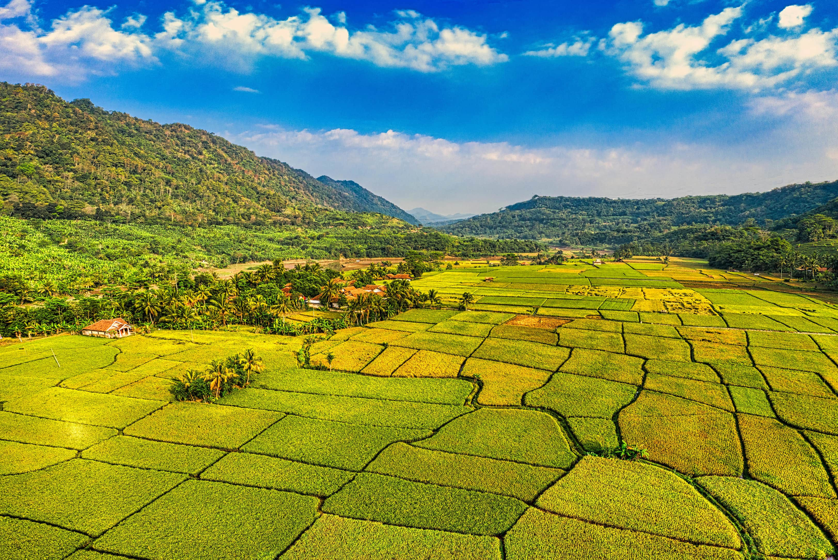

Data Challenges
Inconsistent crop and region naming
Missing and incomplete records
Seasonal and regional data imbalance
Difficulty in combining climate, soil, and market data
Need for standardized data preparation
This extensive data scope is crucial for robust multi-dimensional agricultural analysis, providing a holistic view of farming operations.

Slide 6
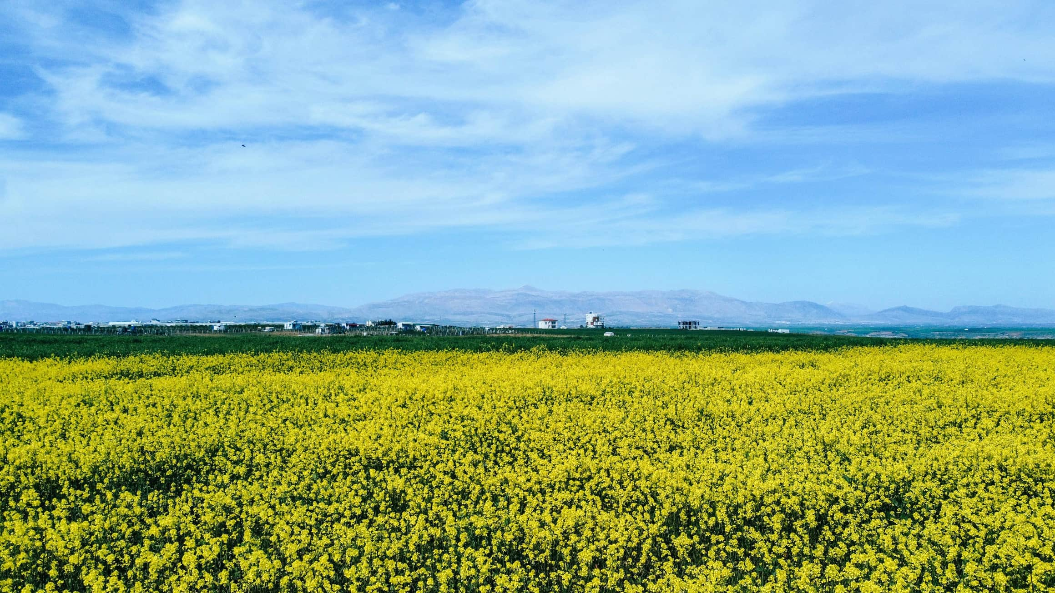
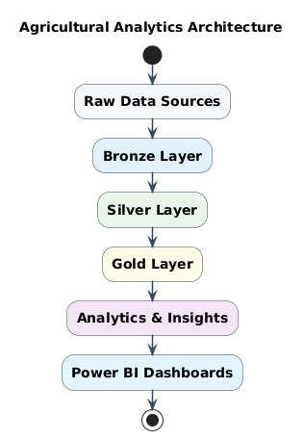




System Architecture
Raw Layer
Original, immutable CSV files from various sources.
Bronze Layer
Raw ingestion of data into Delta tables, preserving original format.
Silver Layer
Cleaned, validated, and standardised data ready for analysis.
Gold Layer
Aggregated and optimised datasets for high-performance analytics and reporting.
Data Flow: Raw → Bronze → Silver → Gold → Power BI

Slide 7
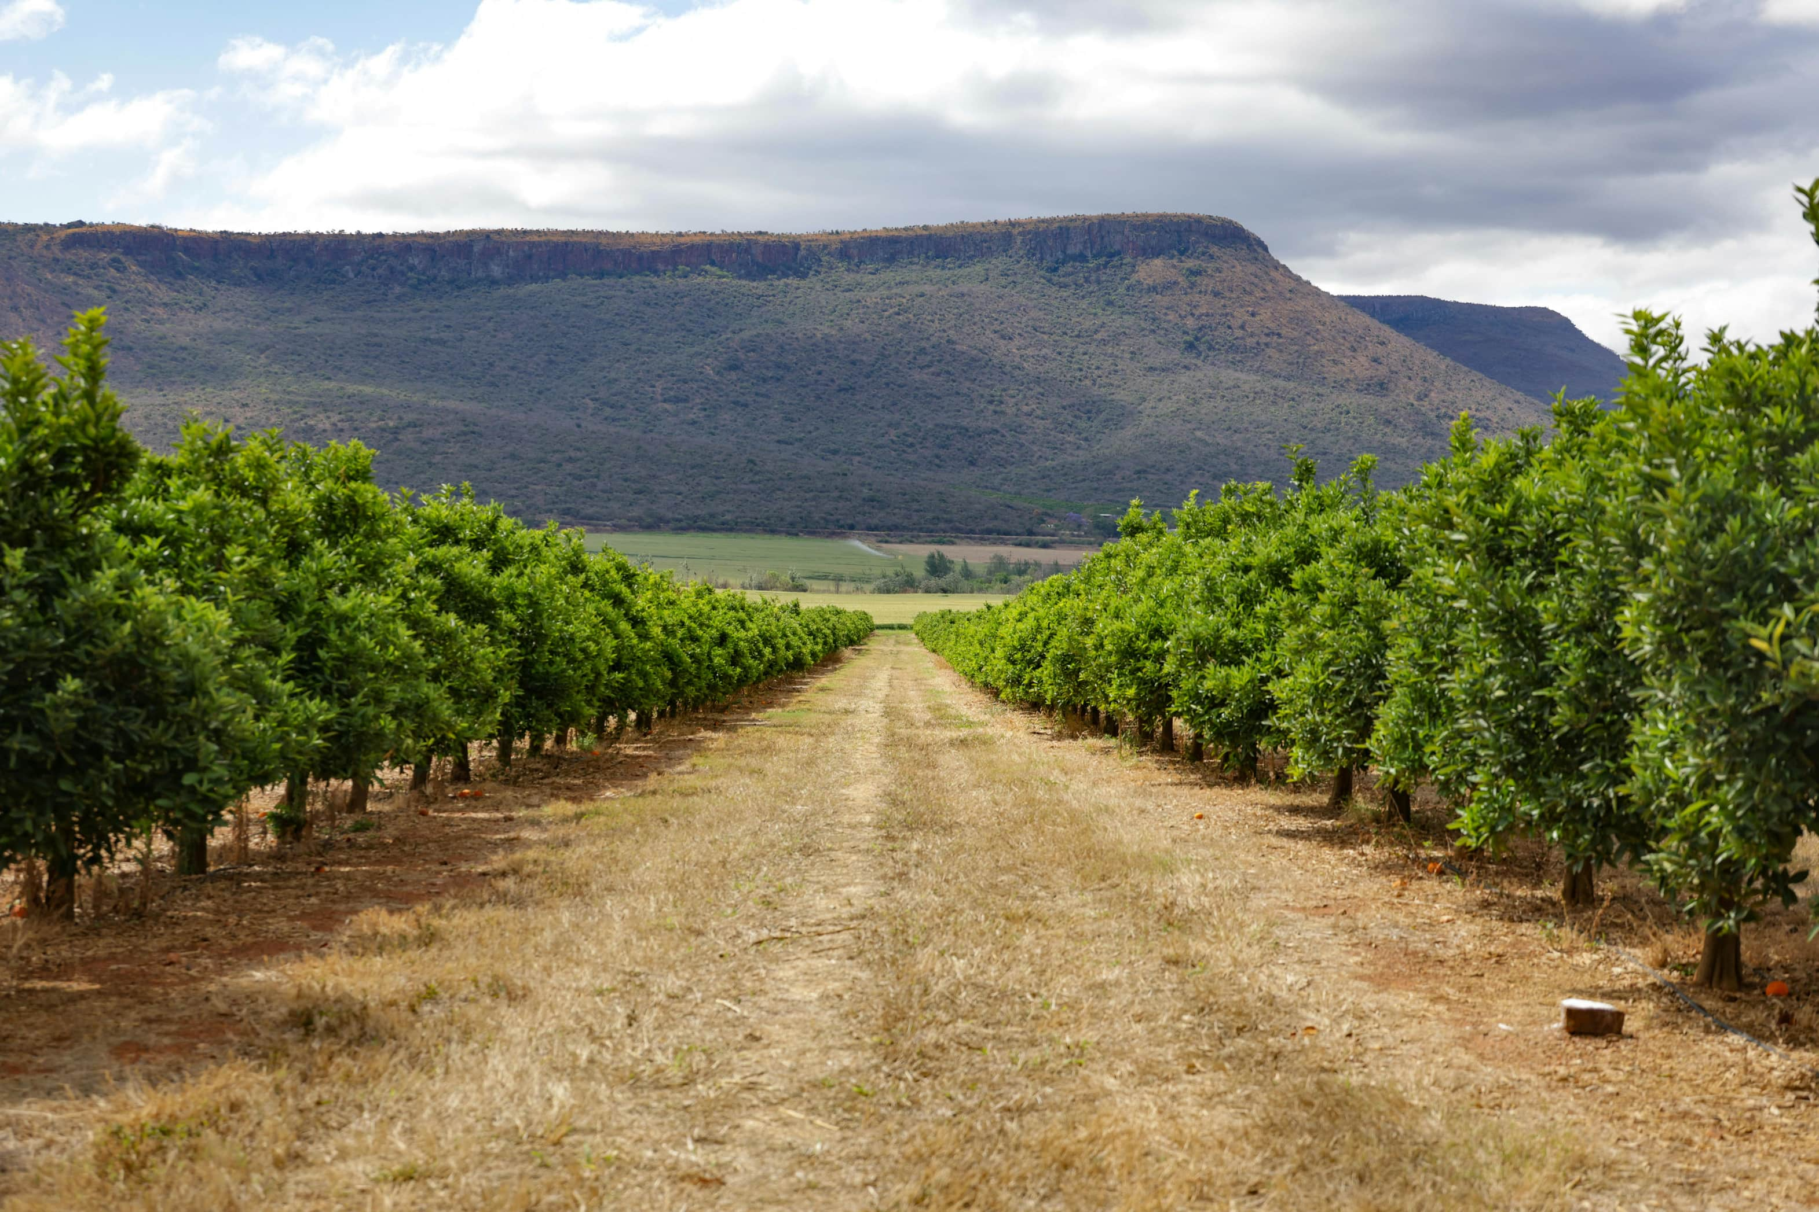
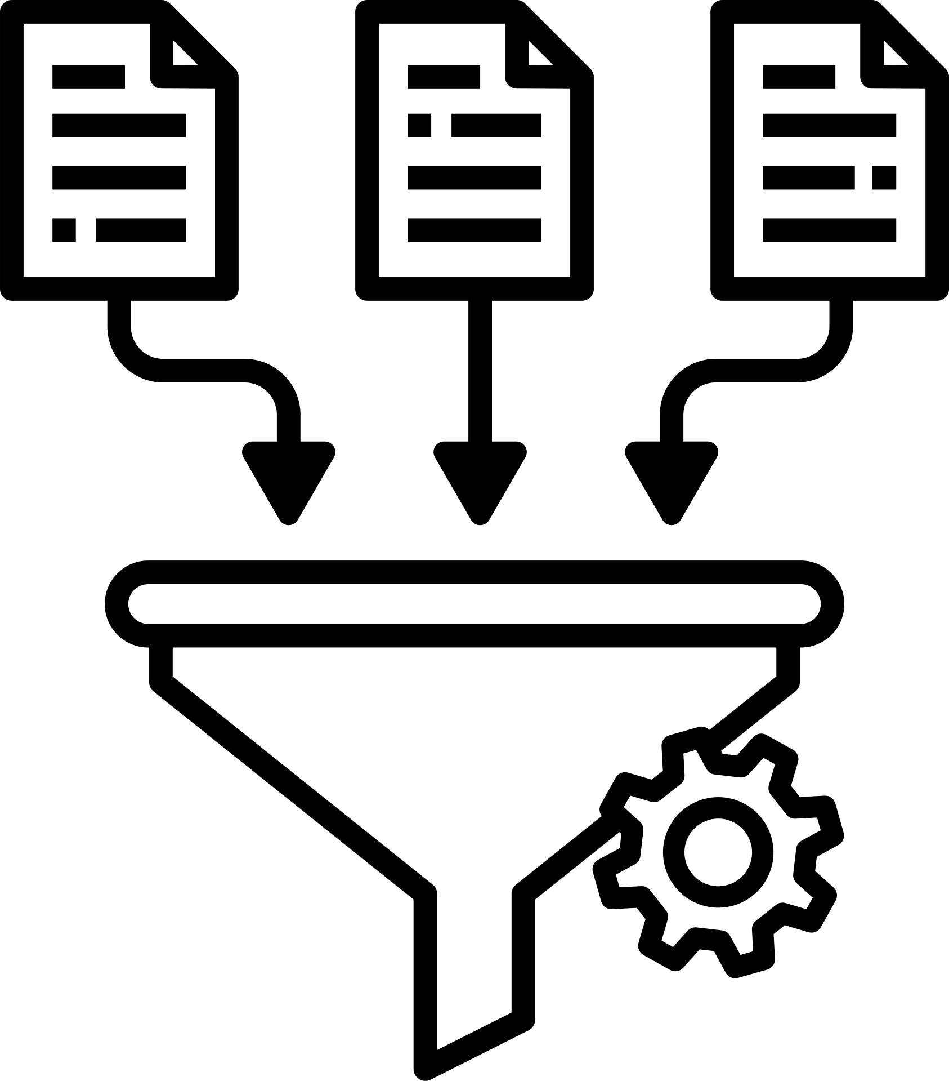


Data Processing
Bronze Layer
Raw data ingestion from source files
Schema validation and basic quality checks
Silver Layer
Data cleaning and standardization
Missing value handling and yield calculation
Gold Layer
Aggregated analytics and insights
Crop, season, region, weather, and soil-based analysis

Slide 8
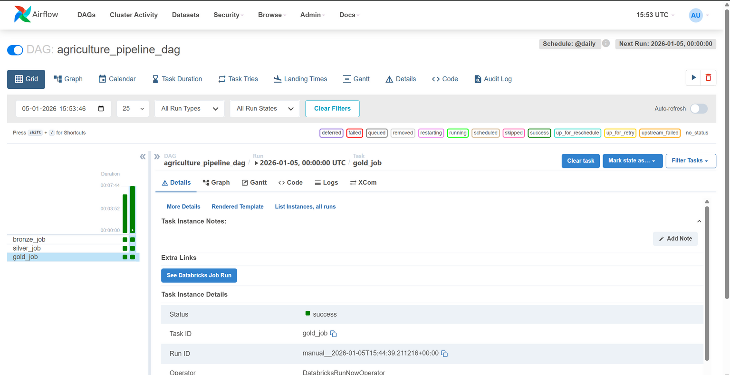
Automated Workflow with Apache Airflow
Pipeline Orchestration
Apache Airflow is utilised to orchestrate the entire data pipeline, ensuring seamless execution.
Scheduled ETL Execution
Daily scheduled ETL (Extract, Transform, Load) processes for continuous data updates.
Sequential Execution
Strict sequential flow: Bronze → Silver → Gold layers.

Slide 9
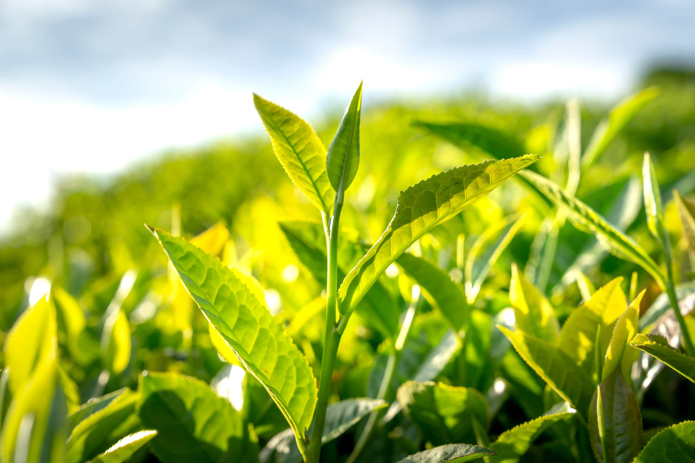
Insights with Power BI Dashboards
1
2
3
Crop Production Trends
Yield Comparison
Market Price Analysis
Visualisation of crop production changes over specified timeframes.
Side-by-side analysis of yield performance across regions and seasons.
Tracking and analysis of crop market price fluctuations.
4
5
Soil Health vs. Yield
Interactive KPIs
Correlation insights between soil indicators and crop yields.
Key Performance Indicators designed for informed decision-making.

Slide 10
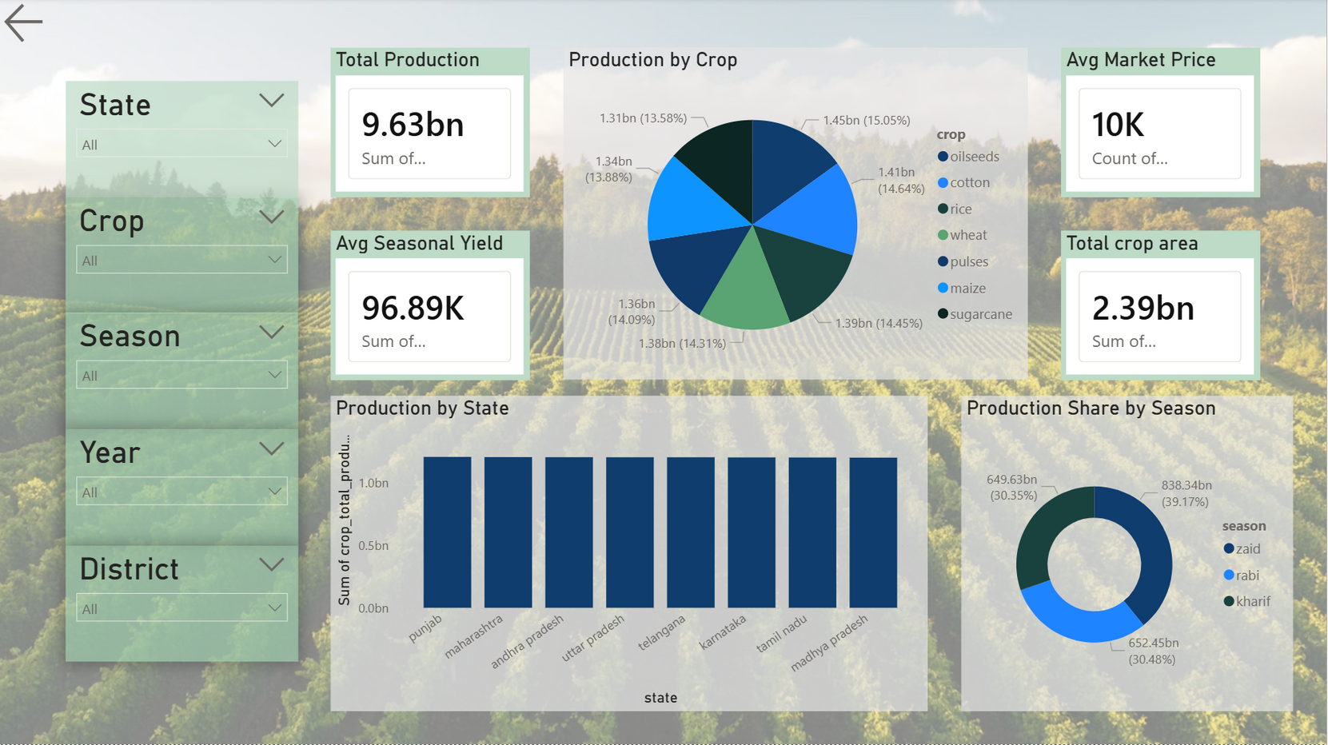
Crop Production Overview

Slide 11
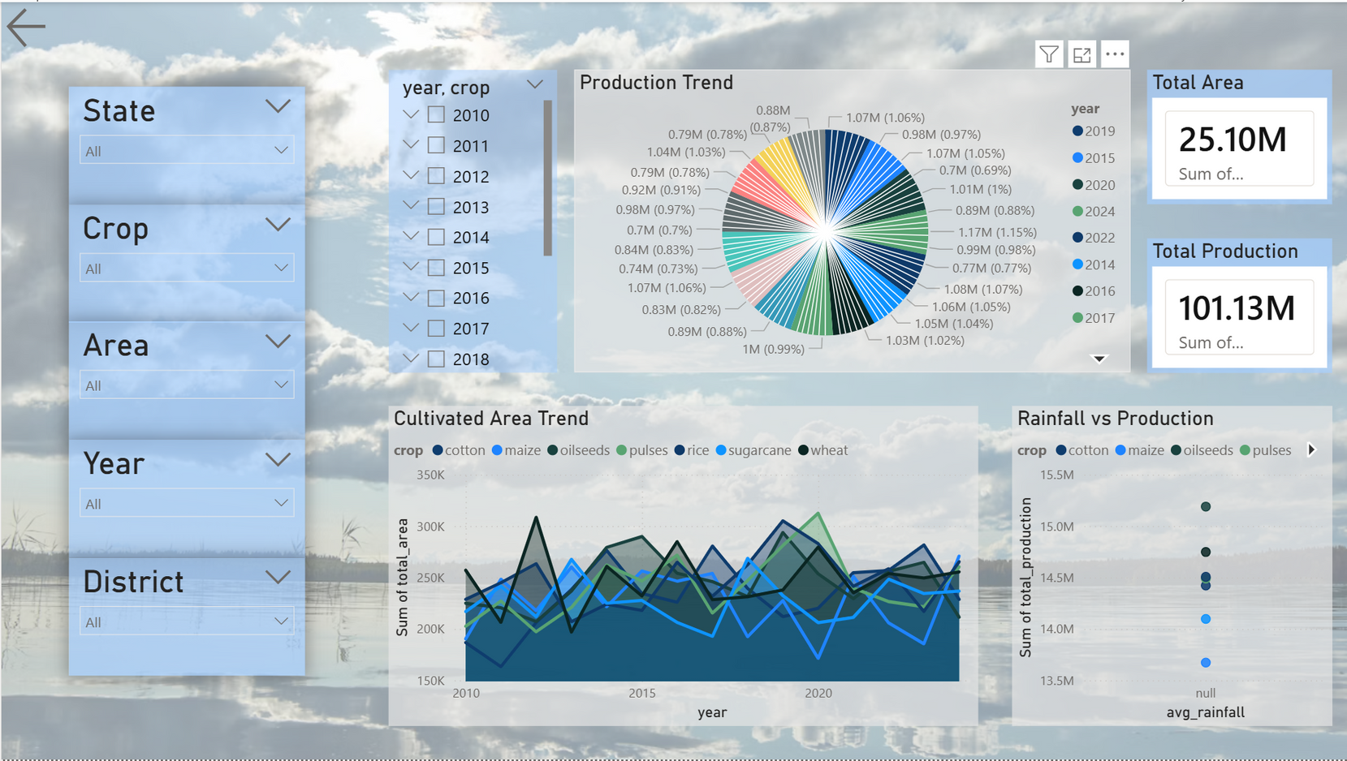
Yield & Weather Performance

Slide 12
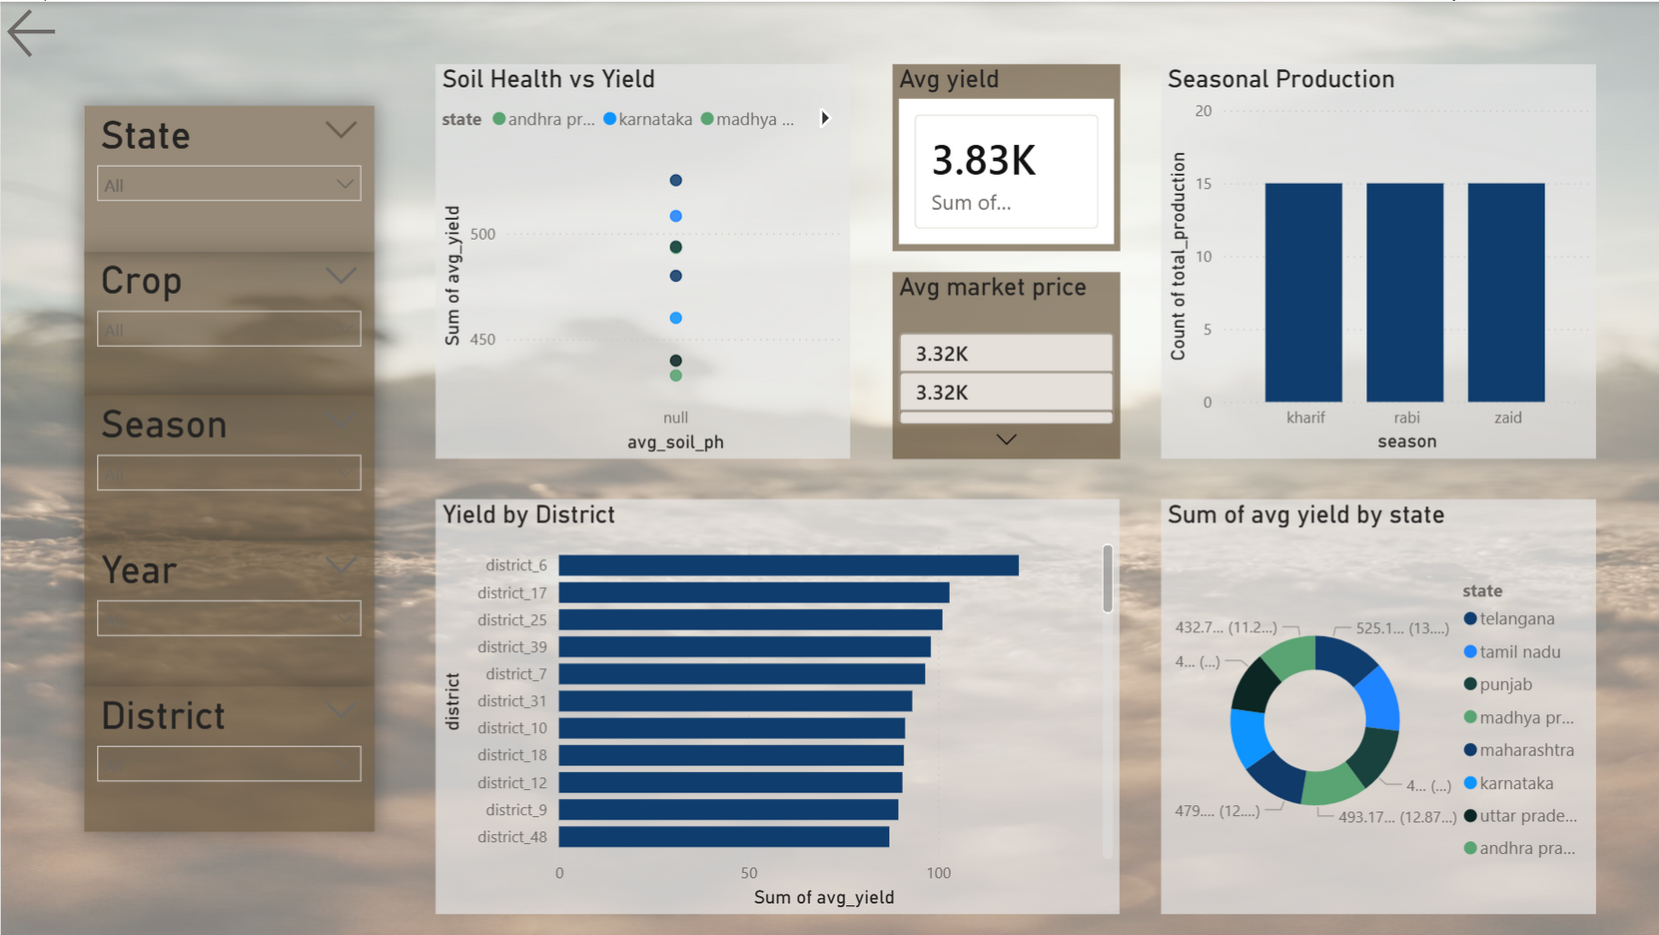
Soil & Market Impact Analysis

Slide 13


Conclusion
Skills & Learning Outcome
Gained hands-on experience in big data analytics
Implemented scalable ETL pipelines
Worked with real-world agricultural datasets
Applied end-to-end analytics and visualization techniques

Slide 14

Thank You !

